Slide 1

Public Cloud Health Care Cloud for Acquired Entities Platform Engineering & Practices

Slide 2


Health Care Cloud | About Us
Health Care Cloud Mission
To build and promote secure, cloud-native solutions.
Health Care Cloud Value
Deliver consistent and secure cloud solutions that serve our enterprise.
Health Care Cloud Vision
Enable safe, fast and cost-effective delivery of health care capabilities on our private and public cloud providers.
2

Slide 3

Public Cloud | Enterprise Enablement
Platform Overview
UHG Enterprise Agreement provides strong data protection and indemnity/liability terms
Leverage 16% service enterprise discount
Enterprise-level CSP support with 15-minute response obligations (dedicated account teams)
Equips all public cloud accounts with SOX required centralized logging and monitoring
Cross platform HITRUST policy-based monitoring
Standardized security policies for AWS and Azure
Detects security vulnerabilities in real-time
Provides Security Incident Response (SIR) and Enterprise Information Security (EIS) read only and break glass access to all public cloud accounts
CSP Well Architected Review for workload maturity
Value
Compliant and secure on day zero of development
Fully automated implementation and refresh
Visibility into account security and compliance
Facilitates remediation of insecure resources
Streamlines security, compliance, and audit reviews
Immediately receive enhancements to improved posture and security as UHG matures cloud adoption
Security Operations Center & Security Incident Response
Account Types at UHG Disposable Cloud Environments (DCE)
Unrestricted developer sandbox accounts
Short lived with weekly financial controls
Standard Cloud Accounts
Dev, Test, Stage, Prod
Billed against business GL
Confidential property of Optum. Do not distribute or reproduce without express permission from Optum.
3

Slide 4

Public Cloud | Launchpad
Accelerating UnitedHealth Group’s Cloud First strategy:
Enabling teams to deliver value safely, quickly and sustainably in the cloud
Application Delivery
Empower teams to leverage every advantage of the public cloud and focus their energy on how to best to deliver their application
Configuration Validation
Enforce compliance through configuration validation and automated remediation
Centralized Logging
Implement logging across resources and enable multiple consumption models
GitOps Enablement
Eliminate repetitive efforts and automate approvals when provisioning resources through managed infrastructure as code

Slide 5

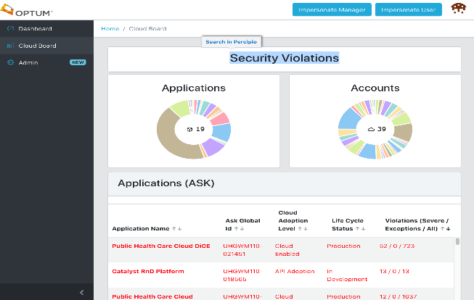
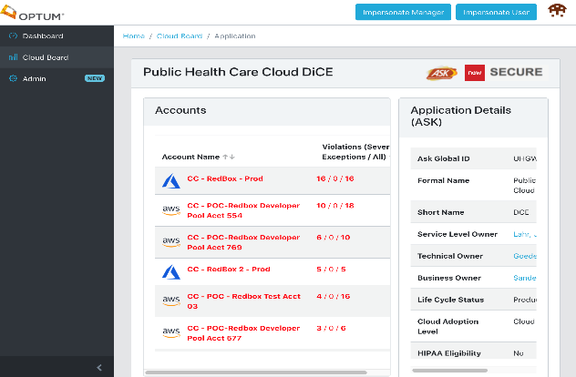
Public Cloud | Cloud Board
Product Overview
Cloud Board is the self-service location for all your accountable actions in Public cloud that tracks, analyzes and displays policy violations, violations history, key performance indicators (KPI), metrics and key data points to monitor the health of an application in Public cloud.
Supports multiple roles and views of Account violations
Connects to Azure, AWS, Service now, Secure and ASK via REST services and API’s to retrieve various account related information.
Value
Fully automated implementation and refresh
Visibility into account UHG security and compliance
Facilitates remediation of non-secured resources
Streamlines security, compliance, and audit reviews
Immediately receive improved posture and security as UHG matures
Ongoing incubation of new policies and hygiene items

Slide 6

Vanguard | Cloud Coaching
Cloud coaching and enablement that provide expertise and experience to get projects started faster, build applications more quickly and optimize costs.
Our Goals
Promote best practices and standard processes that generate repeatable success
Provide as-needed expertise to solve specific problems
Help teams become self-sufficient in knowledge and expertise
Provide VOC back to the HCC product and delivery teams
Cloud Playbook
Training /
Events
Vanguard: Accelerating Cloud Adoption
and Digital
Transformations
Customer Engagements
Community
Engagements

Slide 7

Public Cloud | New Entity Integration
Day 1 - UHG Account Transfer
Move account under UHG Enterprise Master Payer Account/Tenant
Transition CSP engagements to authorized CSP support team
Secure root credentials
Day 1-30 - Integrate Public Cloud Accounts
Complete administrative activities (cost center, named owner, entitlement)
Apply Launchpad to all accounts, introduce DCE to engineers, review Cloudboard
Assess severe security findings along with hygiene issues
Introduction with UHG’s Cloud Service Provider’s account/architectural team
Day 30+ - Operate Public Cloud Accounts
Remediate severe vulnerability findings (within 30 days per policy)
Complete application documentation requirements (intake.md)
Access/leverage supporting resources for architecture, PoC, and delivery efforts
Mature workloads to supported patterns/best-practices, partner with Vanguard if/as needed
Confidential property of Optum. Do not distribute or reproduce without express permission from Optum.
7
Notes:
Intent with Day 1 – Try to phrase the very first steps (rolling into our master account) as a fundamental requirement for UHG owning the asset – just like we roll Azure teams into our EA
****we do NOT accept affiliate agreements
Intent with Day 1-30 – Set a check list of activities to complete within the first 30 days
Intent with Day 30+ - Set clear remediation expectation and follow up efforts

Slide 8

Public Cloud | Cloud Enablement Recovery (ISA)
Chargeback Estimate | Description
$100,000 | Previous actual usage chargeback
$84,000 | Previous actuals less 16% UHG discount
$16,000 | Plus 20% enablement cost on discounted actuals
$100,800 | New monthly actuals including enablement costs
$5,000 | Monthly flat fee
$105,800 | New Monthly Estimated Chargeback
Cloud Enablement Costs (Year 1)
20% Enablement Costs*
16% Cloud Service Provider UHG discount
Net approximately 1% increase for Year 1 with signed ISA
Example
$5,000 Monthly flat fee for all accounts
Direct Costs to AWS and Azure
Cross region logging backend
Baseline per acct minimum costs for multi region logging
Baseline log streaming
Costs to facilitate streaming of baseline account logs
Privileged identity
Per user costs to facilitate privileged access
CI/CD per cloud account
Costs for continuous update/delivery for each account
Internal Administration Tools
Support tools for account and finance administration
20% Enablement Costs*
5% Enterprise Support paid to AWS/Azure.
Requires $75,000 per year support spend minimum
8% for Splunk/Log Searching
Optum Technology license costs for SIEM and app logging support
7% Centralized Logging/Launchpad infrastructure
Azure/AWS green dollar expense for bandwidth and storage.

Slide 9

Public Cloud | Cloud Enablement Recovery (Optum Rate Card)
Cloud Enablement Costs (Year 2)
Subsequent years follow same cost structure
50% Enablement Costs
16% Cloud Service Provider discount
Net approximately 31% increase for Year 2
Chargeback Estimate | Description
$100,000 | Previous actual usage chargeback
$84,000 | Previous actuals less 16% UHG discount
$42,000 | Plus 50% enablement cost on discounted actuals
$126,000 | New monthly actuals including enablement costs
$1,000 | Monthly flat fee
$127,000 | New Monthly Estimated Chargeback
Example
$1,000 Monthly flat fee for each account
Direct Costs to AWS and Azure
Cross region logging backend
Baseline per acct minimum costs for multi region logging
Baseline log streaming
Costs to facilitate streaming of baseline account logs
Privileged identity
Per user costs to facilitate privileged access
CI/CD per cloud account
Costs for continuous update/delivery for each account
Internal Administration Tools
Support tools for account and finance administration
50% Enablement Costs*
5% Enterprise Support paid to AWS/Azure.
Requires $75,000 per year support spend minimum
8% for Splunk/Log Searching
Optum Technology license costs for SIEM and app logging support
7% Centralized Logging infrastructure
Azure/AWS costs for bandwidth and storage.
30% Development and support of Launchpad, Central logging, CloudBoard, and enablement.

Slide 10

Public Cloud | Access & Permissions
Console Access
Permitted through federated identity or synced identity
No Cloud native users with Console access
Custom Roles and Permissions
Custom roles/groups are easy to configure within the federation and sync services
Permissions for the custom roles/groups are configured by individuals with the Admin/Owner role.
Self service
Command line, CLI, Powershell, etc
Permitted through federated identity or synced identity
Access Keys / Service Principals
Permitted
Keys rotated every 90 days.
Permissions
Admin and Owner permissions remain
Root user / Global Admin access retained by Public HCC & IAM team.
Identity Synchronization
AWS: MSID
Azure & GCP: ENTID

Slide 11

Public Cloud | Frequently Asked Questions
We are a Care Delivery Organization, what does this mean for OptumCare?
We all work closely together, including with the OptumCare team. All this means is how we place your Azure workloads for CDO co-management and integration.
My organization runs Office365, does this matter?
Yes. But only in terms of Azure placement and how the UHG Office365 team and/or OptumCare will help merge/manage. If you are ONLY running O365, and NO Azure IaaS, we will help you down another path.
I wish to have my own Azure Tenant, how can I do this?
Let’s talk about your business and technical needs and how to meet those. We do not offer standalone Tenants unless we encounter a technical or other barrier.
We can’t afford the chargeback, how do we address this?
Understood. This might have been unplanned rate card expense for your small business. We offer the ISA for the 1st year to ease costs while you fully move to Optum Rate Card long term.
We pay a 3rd party service provider for similar services now, why move?
Contractual, indemnity, risk centralization.
I’ve spoken to my managers/leaders and we wish to stay as-is, how do we do this?
I’m sorry, this is not an option. Our UHG Corporate Compliance Standard doesn’t allow standalone workloads.

Slide 12

Public Cloud | Control Standard
Public Cloud Control Standard (via eGRC)
10A.1.05 Public Cloud Accounts
Public cloud accounts, subscriptions, and projects (“Accounts”) must be procured, provisioned, and governed in accordance with the Public Health Care Cloud program.
Accounts established or managed outside of the Public Health Care Cloud Team’s program shall be decommissioned or transition to the Program.

Slide 13
Public Cloud | Public Cloud Safely
Compliant (Legacy Security Model)
Rules based on legacy architecture and delivery practices
Responsibility with approvers instead of core team
3rd Party, limited scope Security & Configuration
More Secure (via Launchpad)
Identify and remediate cloud configuration vulnerabilities
>6,500 findings YTD; 80% closed within 24 hours; 99% closed within 1 week
Integrate multiple leading tools with security incident response.
50+ daily attacks against UHG Public Cloud Infrastructure
Eliminate idle assets and escalate activity spikes
675+ responses and account closures
Close gaps with credentials, secrets, MFA, root access, and least permissions
100s of unmanaged, external, full administrative access identified and remediated
Automatically address logging requirements of cloud resources
10,000s of log integrations automatically configured. Add your app logs and access via Spunk!

Slide 14






Public Cloud | Disposable Cloud Environment (DCE)
Product Overview
DCE provides time based and spend-limited Azure and AWS accounts
Accounts are leased for a period of seven days. After the time has expired, the account is reset and returned to a pool of accounts to be leased again
Includes an auto-provisioned GitHub repository, CI/CD pipeline, and automated workshop dashboard
Value Accelerates Cloud Adoption and DevOps Modernization by:
Reducing the time to get started with instant access to DCE following manager approval
Eliminating enterprise account intake for sandbox efforts only, reducing operational overhead, end-user cost, and security risk
Isolating and removing security risk weekly on behalf of DCE users. This provides a safe space to learn new security expectations and responsibilities in the public cloud.
Controlling infrastructure spend by default
Providing paved paths for teams to quickly learn infrastructure-as-code (IaC) and other best practices for cloud-native development
Open Source DCE:
Increases Optum’s reputation as a trusted open source contributor while promoting talent acquisition and retention
Positions Optum to build a stronger, more innovative cloud product by leveraging talent and perspective beyond the enterprise, supplying continuous feedback for product growth
Fast Access
Budget Protection
Weekly Reset
Easy IaC
Launchpad Security & Compliance

Slide 15

Public Cloud | Community Support & Resources
Training
Optum Technology University Classes
Cloud Service Provider Hosted Courses
Flowdock & Office Hours
Community messaging channels to support others in Cloud journey
Service Provider and Office Hours for CSPs and UHG
Cloud Service Provider Engagements
Health Care Cloud Team with CSPs for Architectural Reviews, Immersion Days, etc.
More Information
HealthCareCloudInternal (https://cloud.optum.com)

